Slide 1
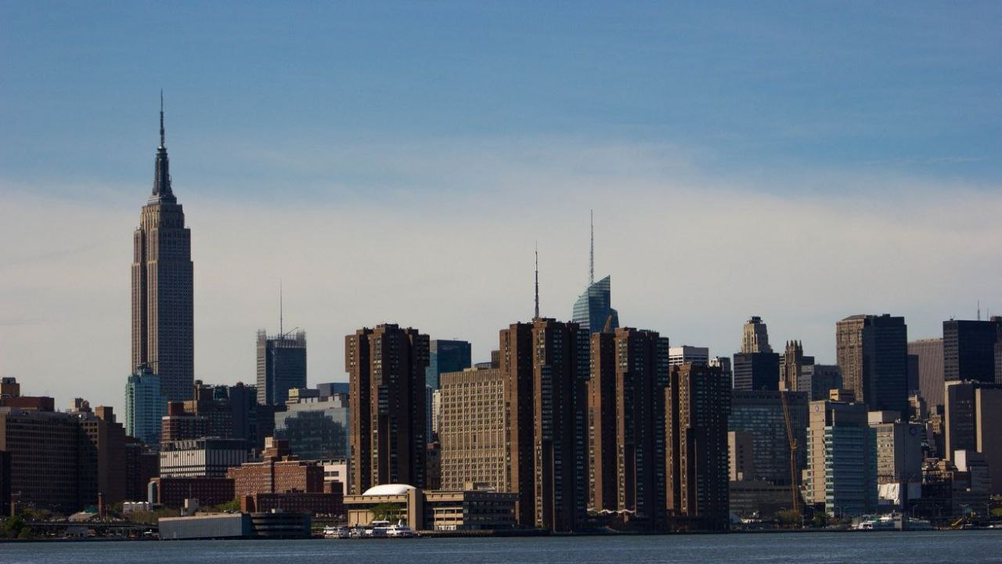

Slide 3
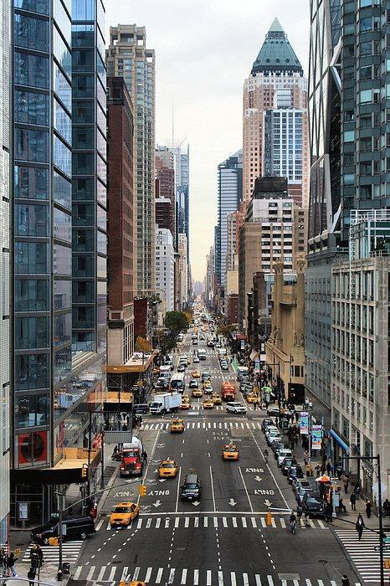
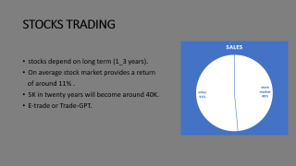
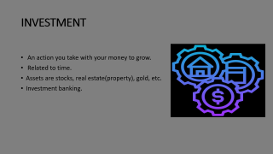
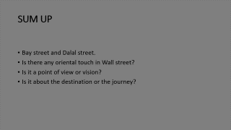

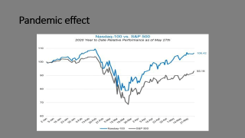


Slide 4

INVESTMENT
An action you take with your money to grow.
Related to time.
Assets are stocks, real estate(property), gold, etc.
Investment banking.

Slide 5
STOCKS TRADING
Stocks depend on long term (1_3 years).
On average stock market provides a return
of around 11% .
5K in twenty years will become around 40K.
E-trade or Trade-GPT.

Slide 6
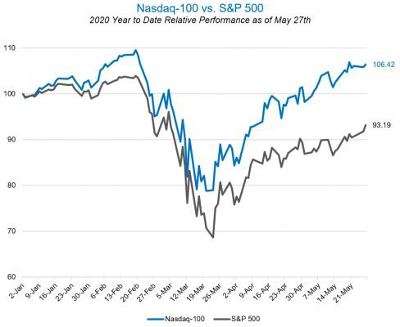
Pandemic effect

Slide 7
SUM UP
Bay street and Dalal street.
Is there any oriental touch in Wall street?
Is it a point of view or vision?
Is it about the destination or the journey?

Slide 8
THANK YOU

